Slide 1
Physics Numericals
Presented By Sir Talha

Slide 2
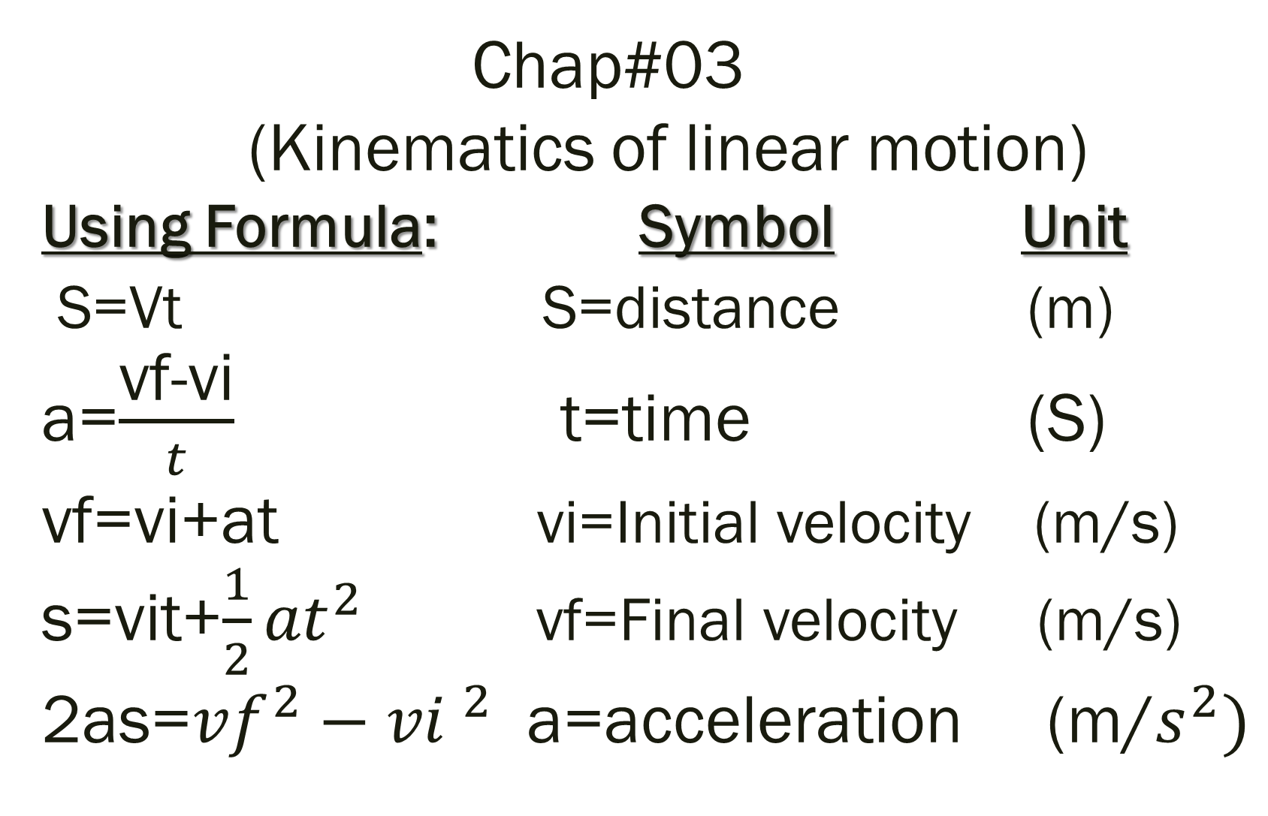
Chap#03 (Kinematics of linear motion) Using Formula: Symbol Unit S=Vt S=distance (m) a=$\frac{\text{vf}\text{−}\text{vi}}{t}$ t=time (S) vf=vi+at vi=Initial velocity (m/s) s=vit+$\frac{1}{2}{at}^{2}$ vf=Final velocity (m/s) 2as=${vf}^{2}−{vi }^{2}$ a=acceleration (m/$s^{2})$

Slide 3
Chap#03 P1# A Motorcyclist Covers 150m in 10sec . Find Speed of the Motorcyclist. (Ans:15m/s)

Slide 4
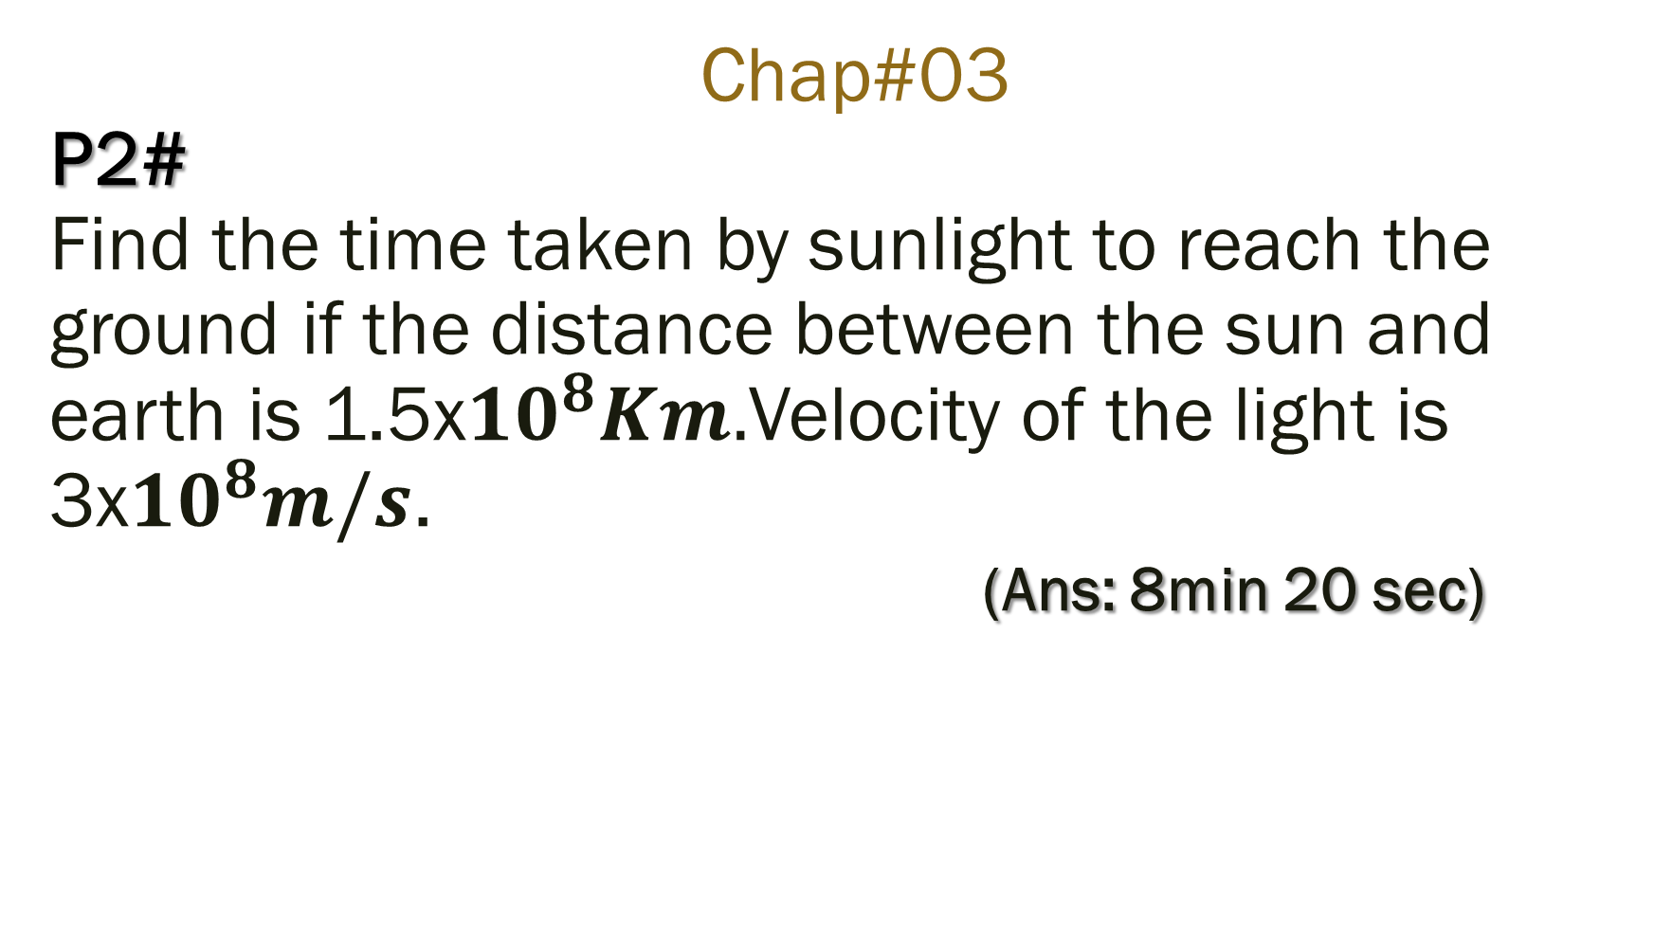
Chap#03 P2# Find the time taken by sunlight to reach the ground if the distance between the sun and earth is 1.5x${10}^{8}Km.$Velocity of the light is 3x${10}^{8}m/s$. (Ans: 8min 20 sec)

Slide 5
Chap#03 P3# A Person hears the echo of his own sound from a distant hill after 2 sec . How four away is the person from the hill if the speed of sound is 330m/s (Ans: 330m)

Slide 6
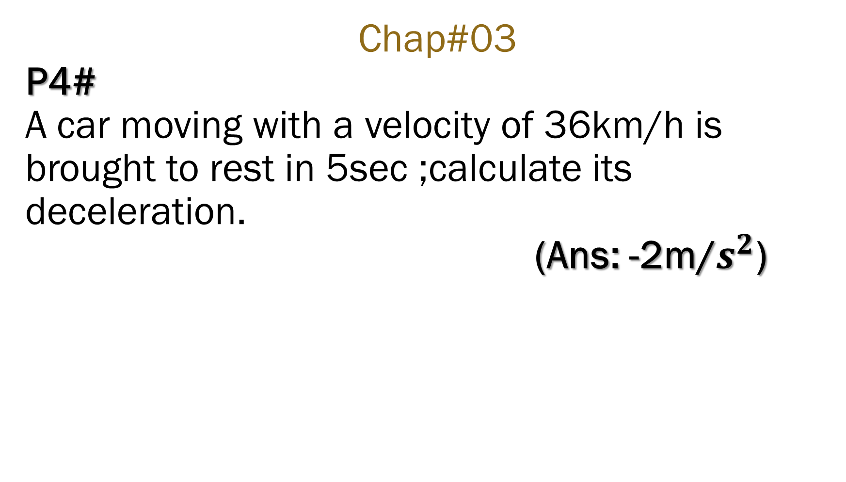
Chap#03 P4# A car moving with a velocity of 36km/h is brought to rest in 5sec ;calculate its deceleration. (Ans: -2m/$s^{2}$)

Slide 7
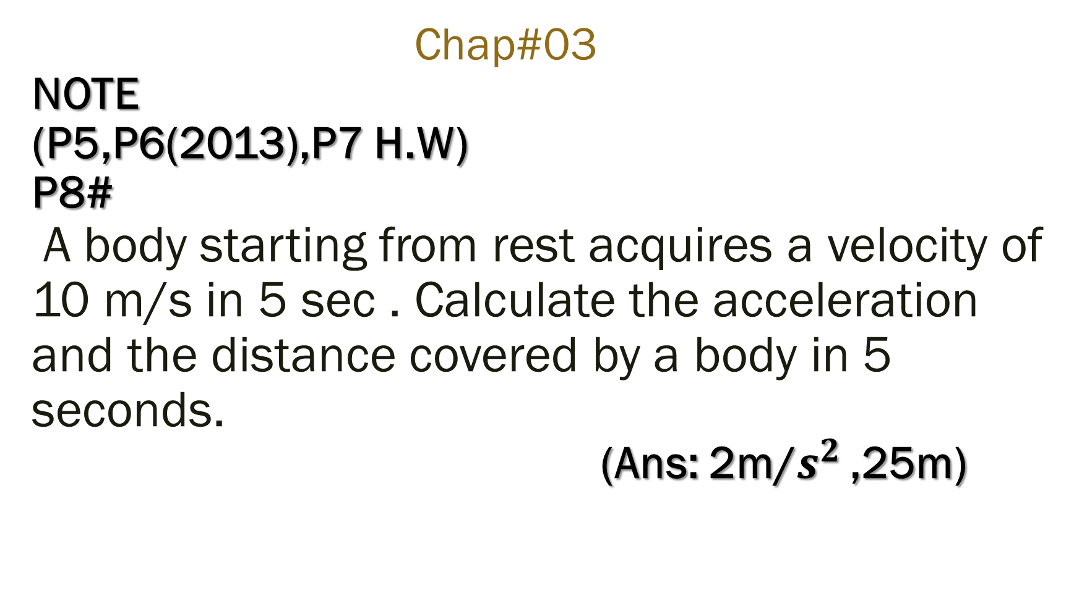
Chap#03 NOTE (P5,P6(2013),P7 H.W) P8# A body starting from rest acquires a velocity of 10 m/s in 5 sec . Calculate the acceleration and the distance covered by a body in 5 seconds. (Ans: 2m/$s^{2 }$,25m)

Slide 8
Chap#03 NOTE (P9,P10(2012),P11,P12 H.W) P13 # (2013) A car starting from the rest attains a velocity 20m/s in 5 seconds. Find the distance cover by the car (Ans: 50m)

Slide 9
Chap#03 NOTE (P9,P10,P11,P12 H.W) P13# A car starting from rest attains a velocity 20m/s in 5 seconds. Find the distance cover by the car. (Ans: 50m)

Slide 10
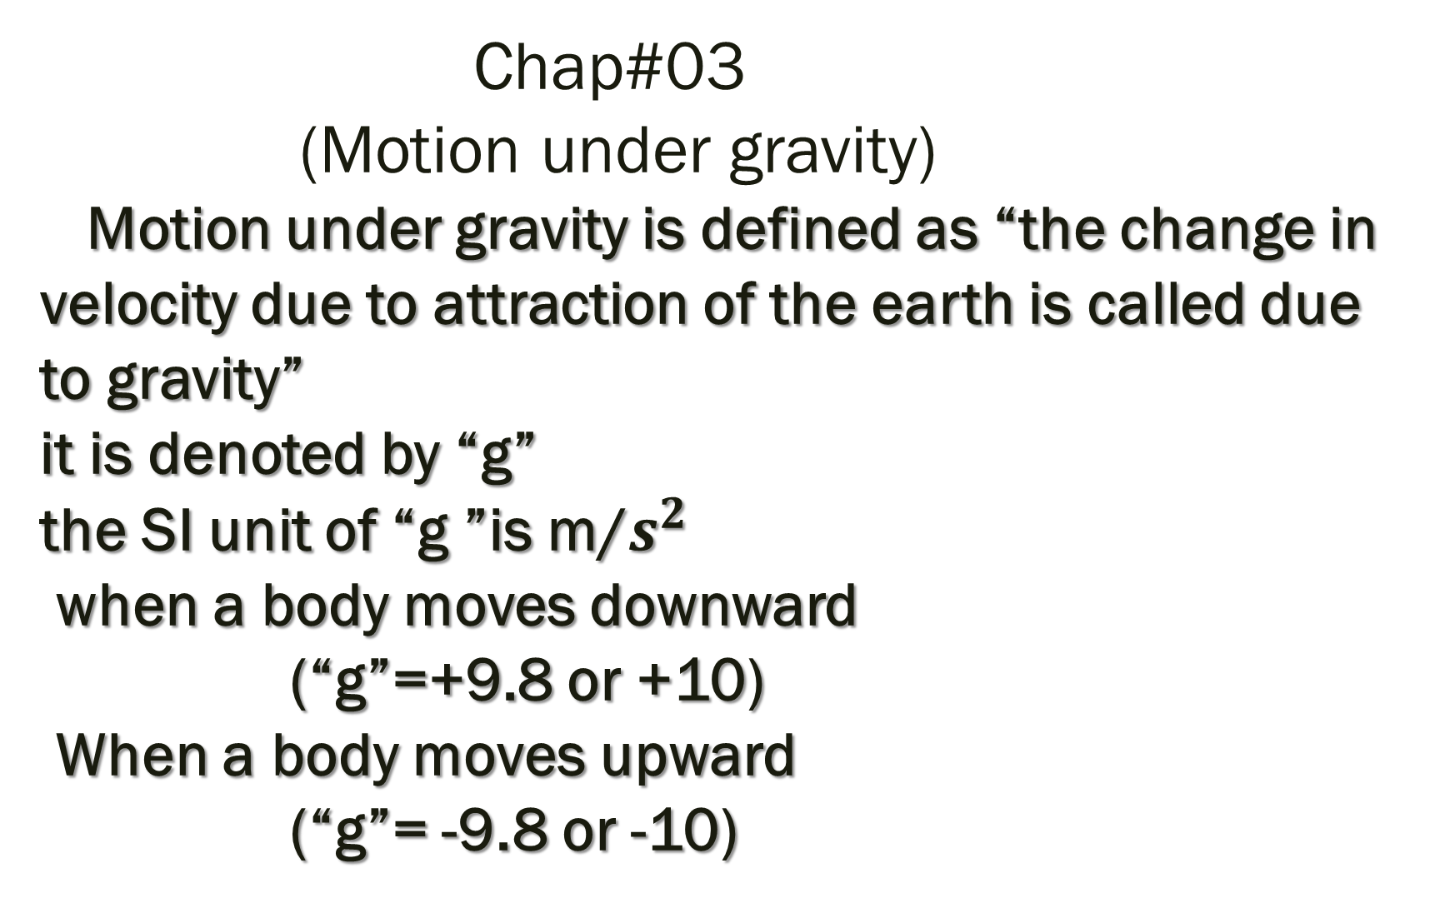
Chap#03 (Motion under gravity) Motion under gravity is defined as “the change in velocity due to attraction of the earth is called due to gravity” it is denoted by “g” the SI unit of “g ”is m/$s^{2}$ when a body moves downward (“g”=+9.8 or +10) When a body moves upward (“g”= -9.8 or -10)

Slide 11
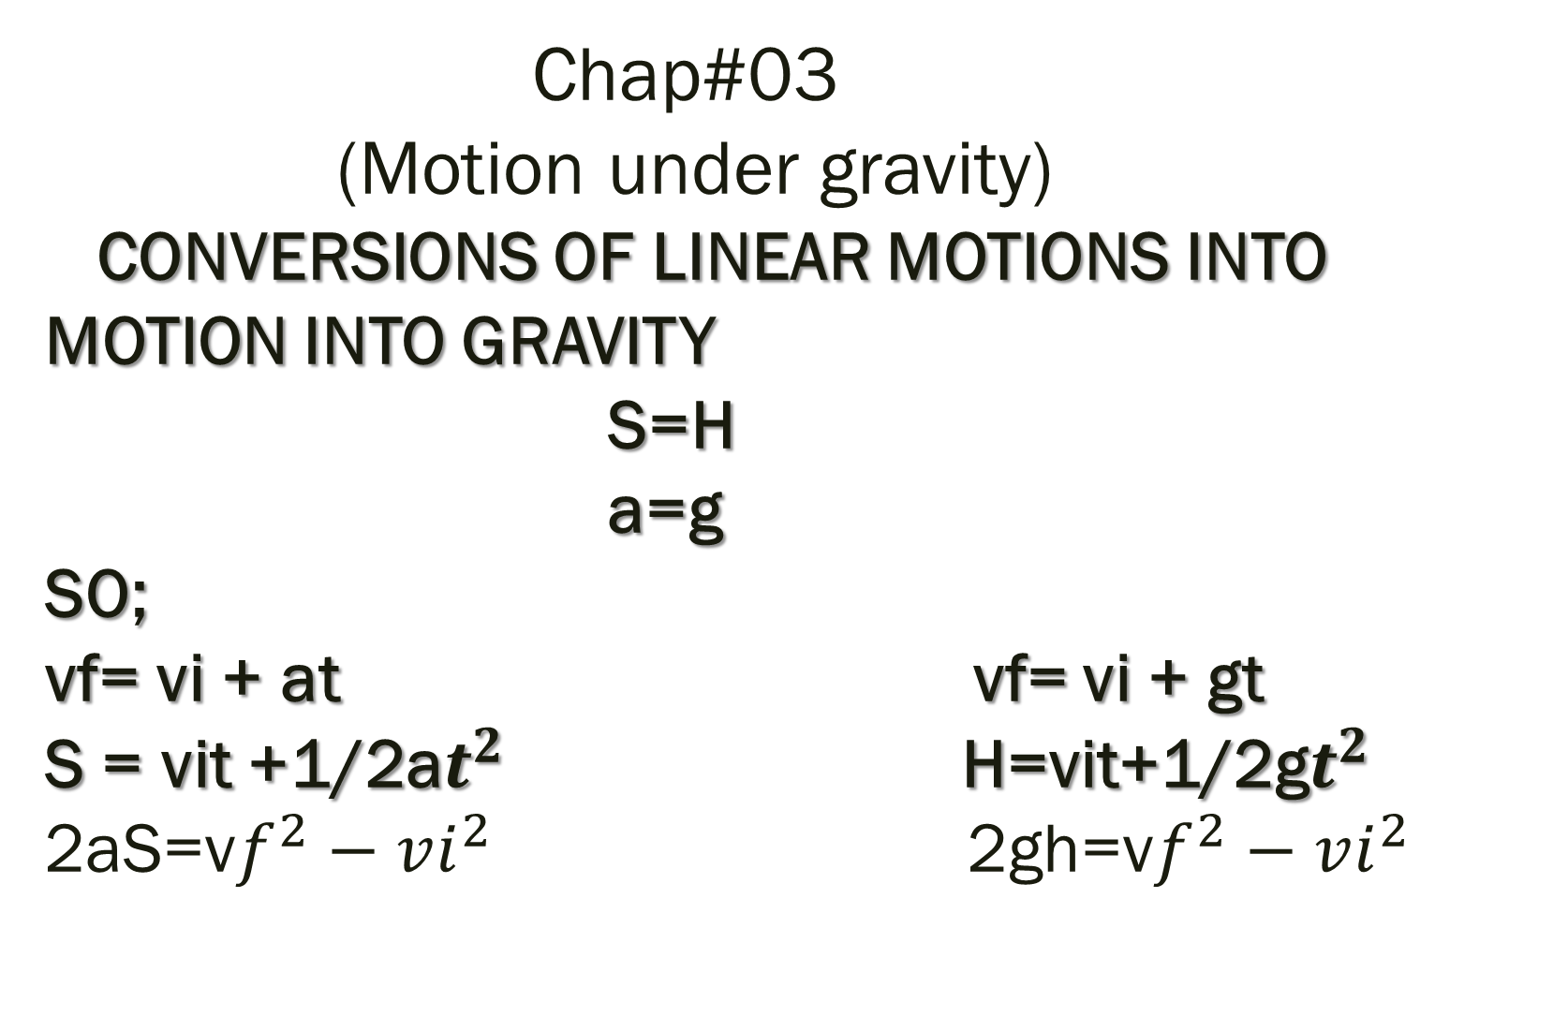
Chap#03 (Motion under gravity) CONVERSIONS OF LINEAR MOTIONS INTO MOTION INTO GRAVITY S=H a=g SO; vf= vi + at vf= vi + gt S = vit +1/2a$t^{2}$ H=vit+1/2g$t^{2}$ 2aS=v$f^{2}−vi^{2}$ 2gh=v$f^{2}−vi^{2}$

Slide 12
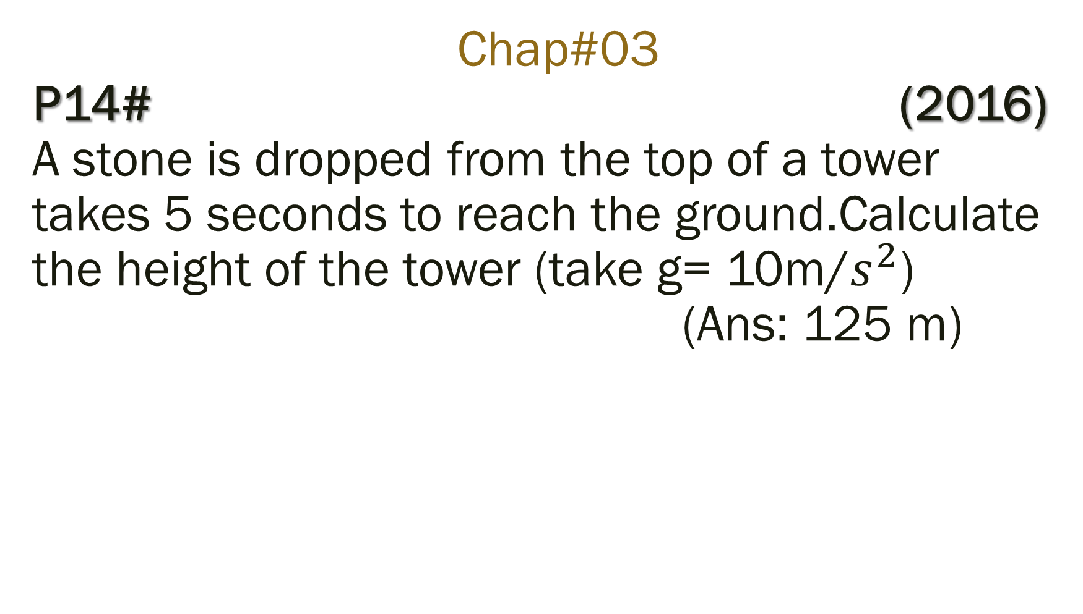
Chap#03 P14# (2016) A stone is dropped from the top of a tower takes 5 seconds to reach the ground.Calculate the height of the tower (take g= 10m/$s^{2}$) (Ans: 125 m)

Slide 13
Chap#03 P15# A boy throws a ball with a velocity of 20m/s.Find the time elapsed between the throwing and catching the ball. (Ans: 4s)

Slide 14
Chap#03 P16# A stone is thrown vertically upwards with a velocity of 20 m/s . Find the maximum height reached by the stone and the total time to flight. (Ans: 20m,4s)

Slide 15
Chap#03 P17# (2009) A ball is dropped from a tower.it reaches the ground in 10 seconds. Calculate the height of the tower and the velocity with which it hits the ground. (Ans: -500m, -100m/s)

Slide 16
Chap#03 P18# (2010,11) A stone is dropped from the height of 40m. a) How much time will take to reach the ground? b) with what velocity will it strike the ground (Ans:2.82 sec, 28.20 m/s)

Slide 17
Chap#03 P18# (2019,18,16) A ball is dropped from a height of 122.5m. How time will it take to reach the ground? (Ans:5sec)

Slide 19
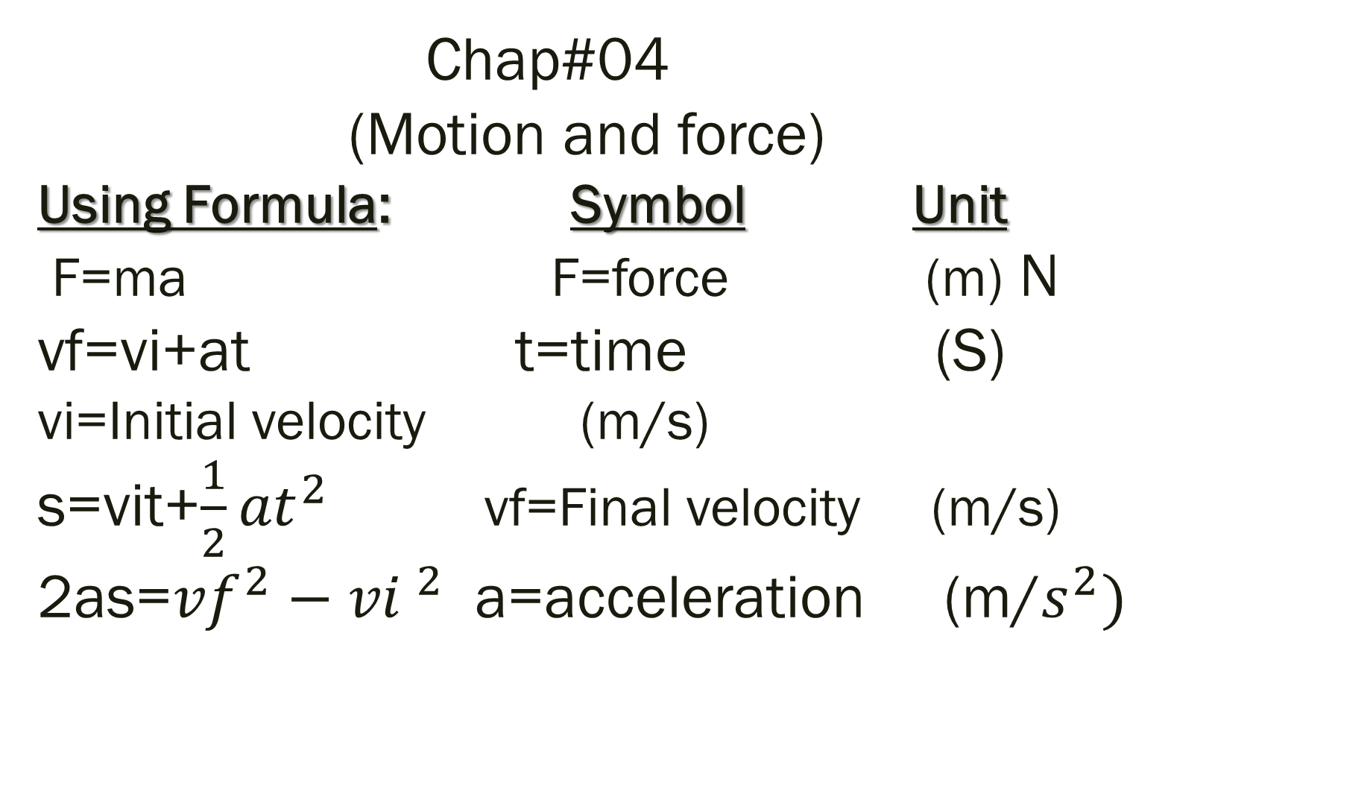
Chap#04 (Motion and force) Using Formula: Symbol Unit F=ma F=force (m) N vf=vi+at t=time (S) vi=Initial velocity (m/s) s=vit+$\frac{1}{2}{at}^{2}$ vf=Final velocity (m/s) 2as=${vf}^{2}−{vi }^{2}$ a=acceleration (m/$s^{2})$

Slide 20

Chap#04 P1# Determine the acceleration of a car of mass 900kg , when a net force of 2700 N acts on it. (3 m/$s^{2})$

Slide 21
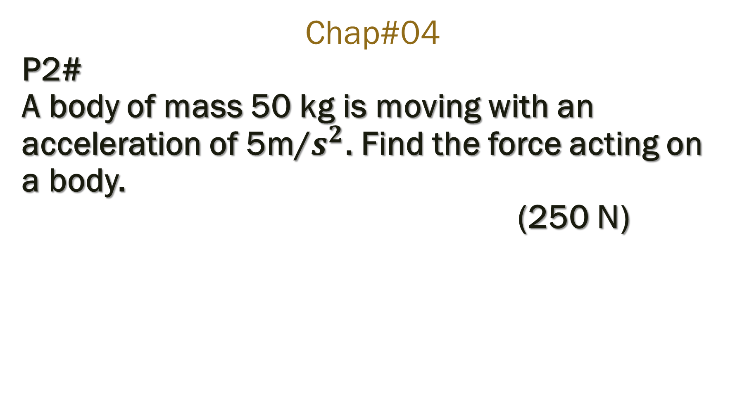
Chap#04 P2# A body of mass 50 kg is moving with an acceleration of 5m/$s^{2}$. Find the force acting on a body. (250 N)

Slide 22
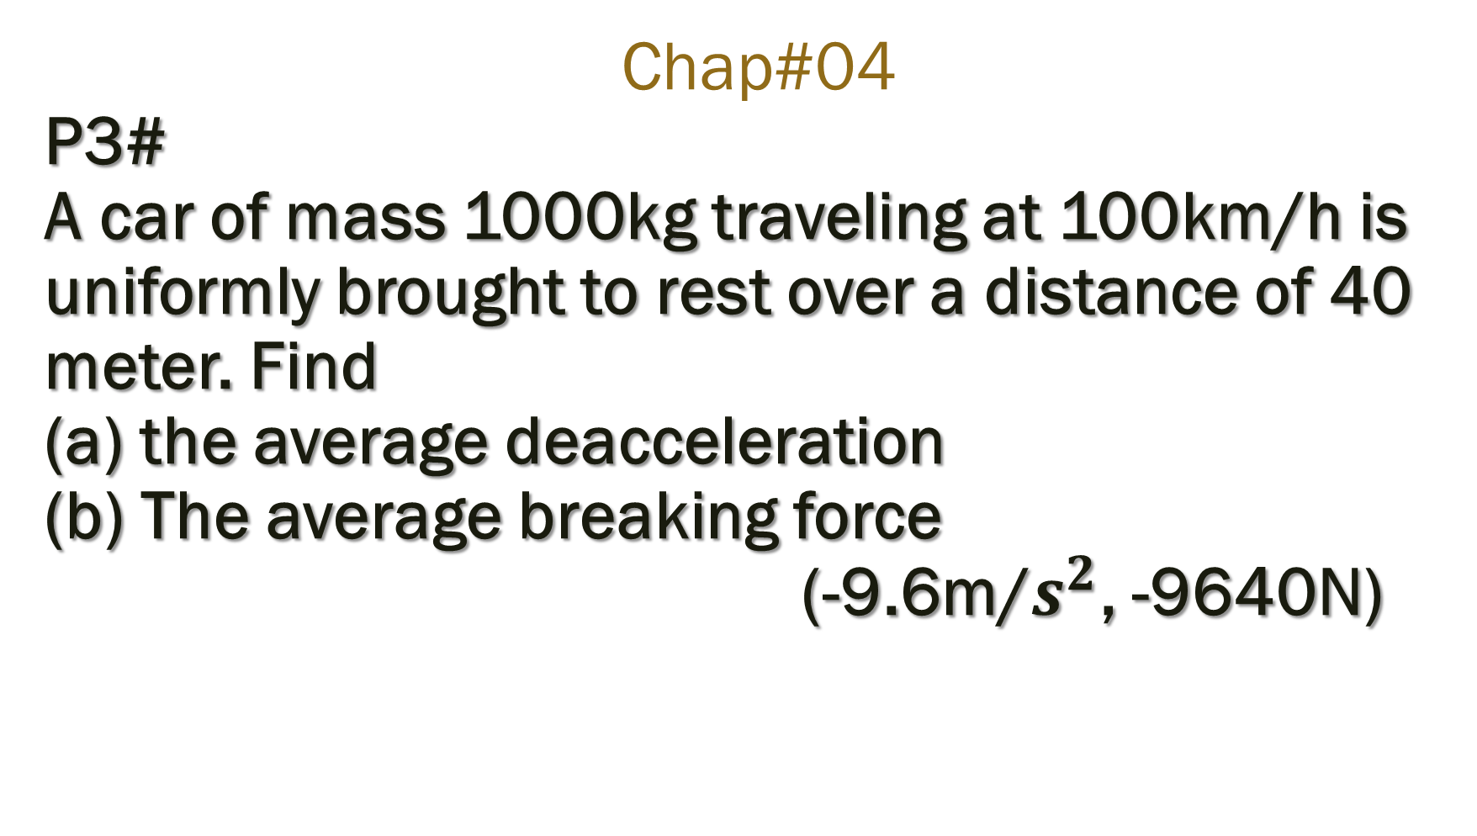
Chap#04 P3# A car of mass 1000kg traveling at 100km/h is uniformly brought to rest over a distance of 40 meter. Find (a) the average deacceleration (b) The average breaking force (-9.6m/$s^{2}$, -9640N)

Slide 23
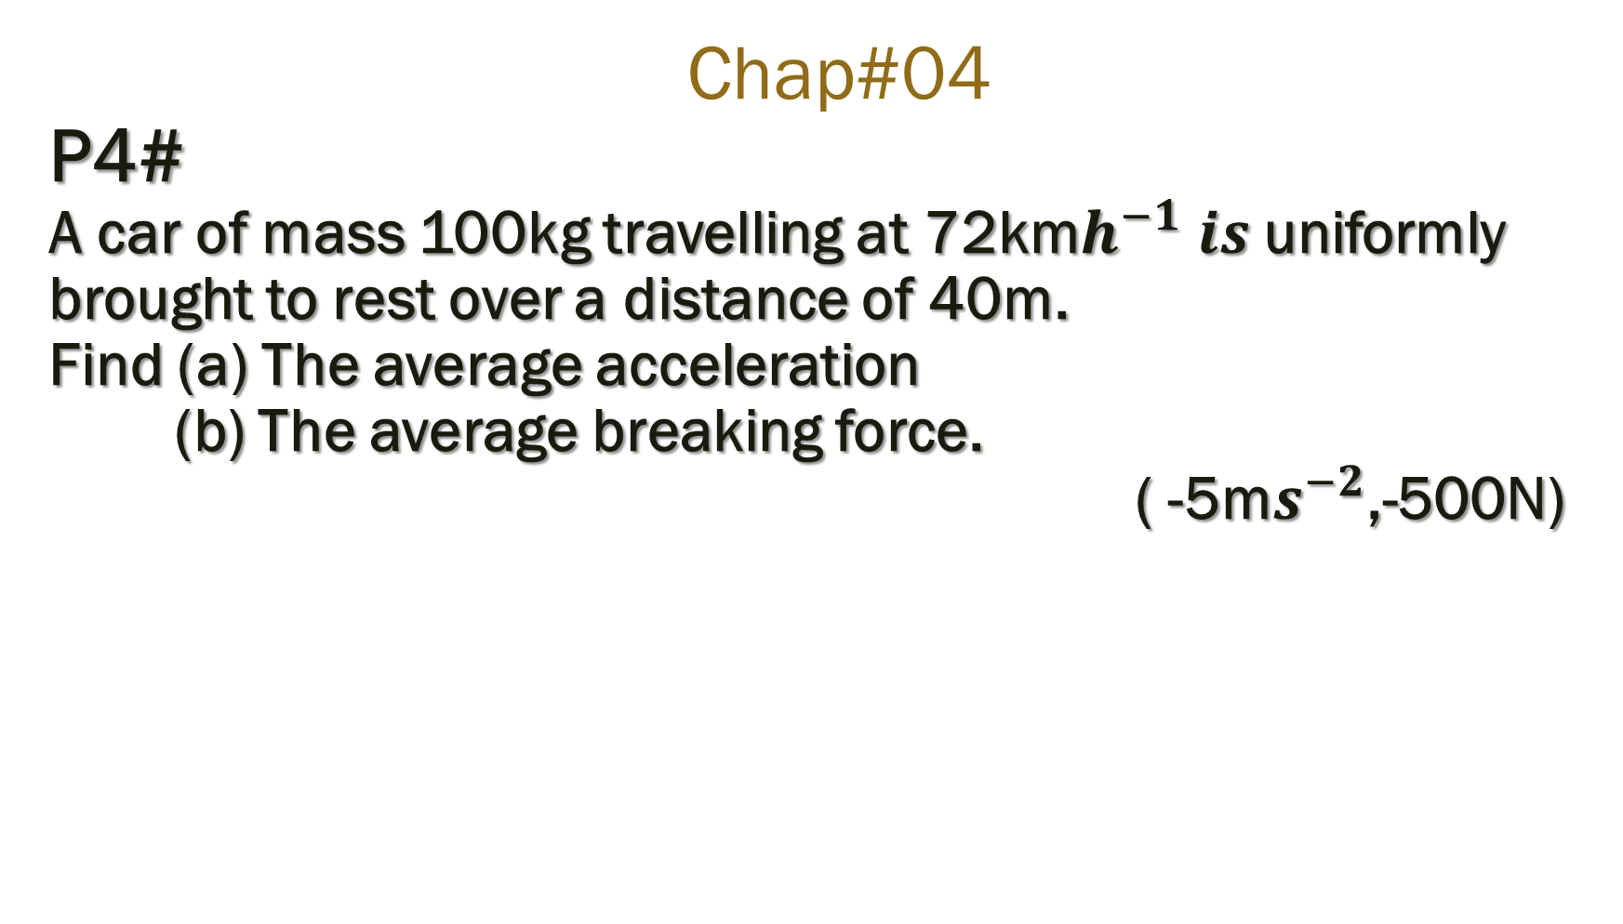
Chap#04 P4# A car of mass 100kg travelling at 72km$h^{−1} is$uniformly brought to rest over a distance of 40m. Find (a) The average acceleration (b) The average breaking force. ( -5m$s^{−2}$,-500N)

Slide 24
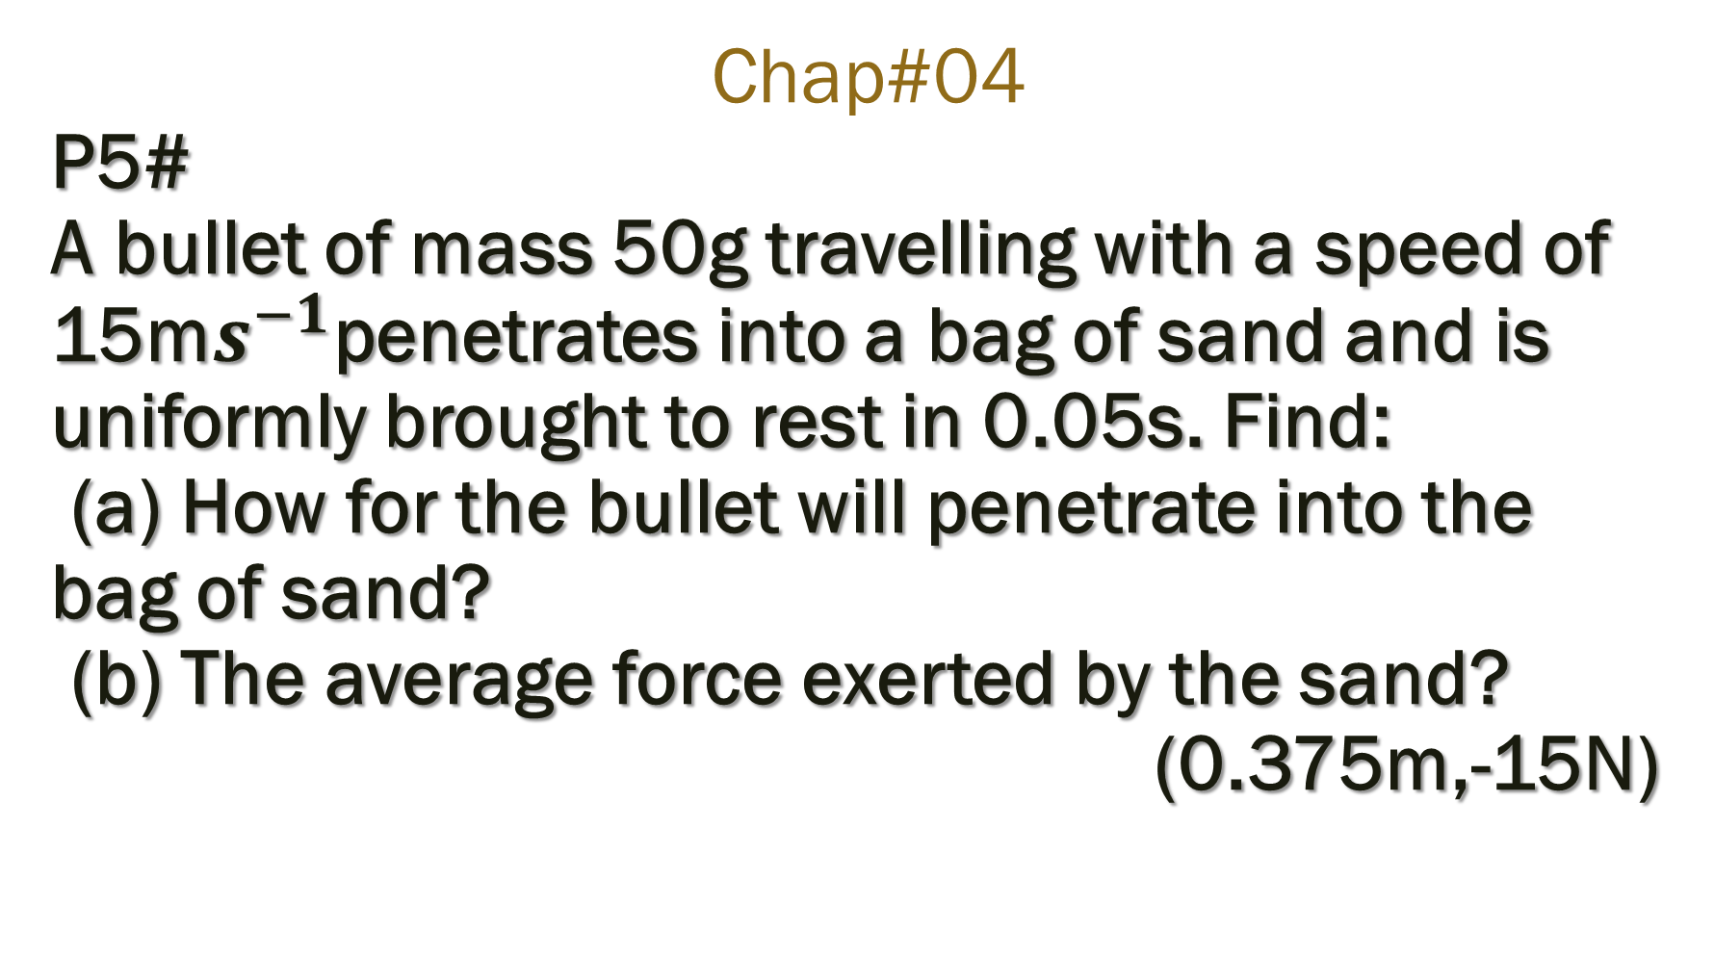
Chap#04 P5# A bullet of mass 50g travelling with a speed of 15m$s^{−1}$penetrates into a bag of sand and is uniformly brought to rest in 0.05s. Find: (a) How for the bullet will penetrate into the bag of sand? (b) The average force exerted by the sand? (0.375m,-15N)

Slide 25
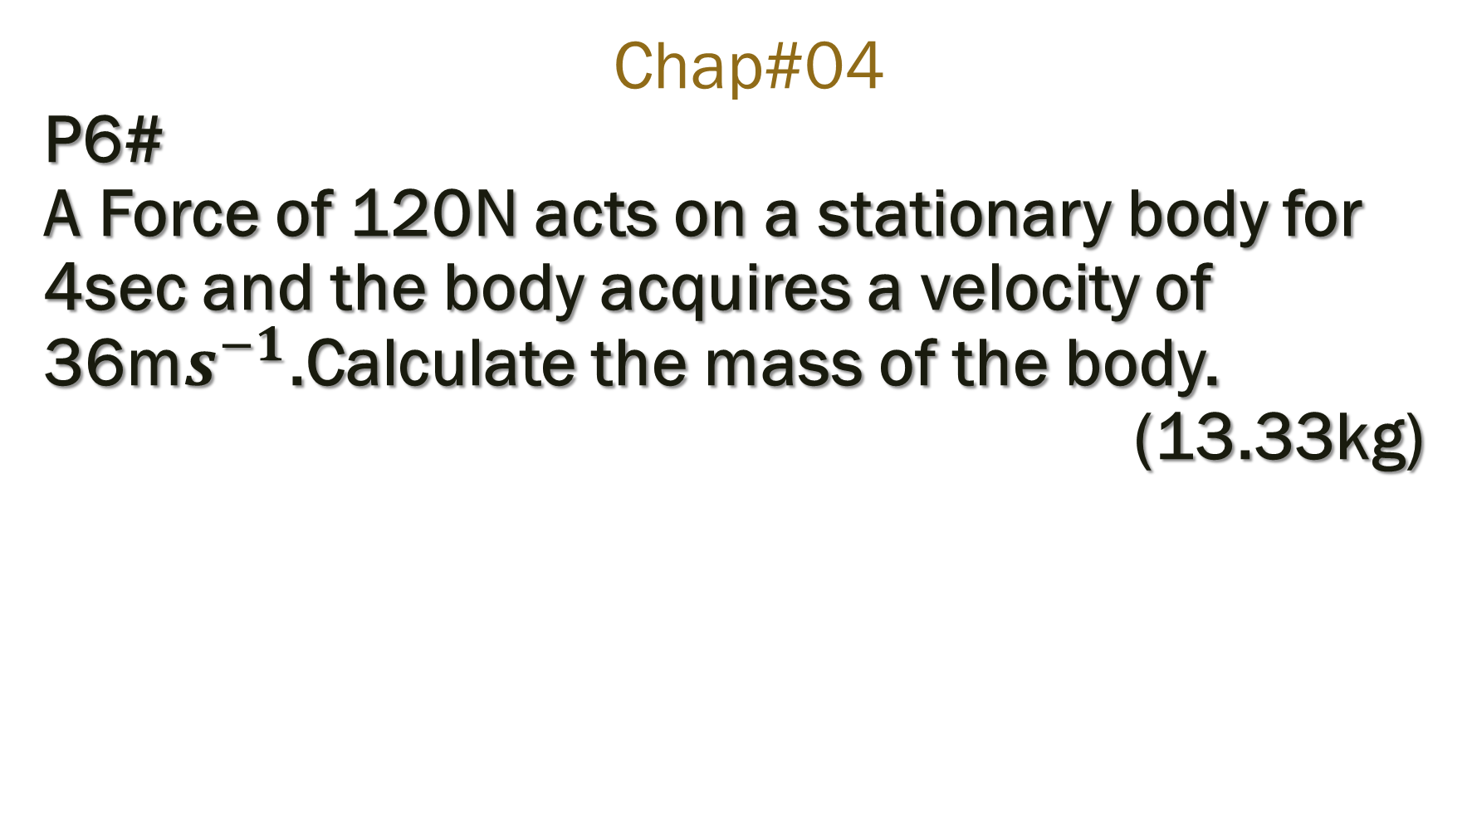
Chap#04 P6# A Force of 120N acts on a stationary body for 4sec and the body acquires a velocity of 36m$s^{−1}$.Calculate the mass of the body. (13.33kg)

Slide 26
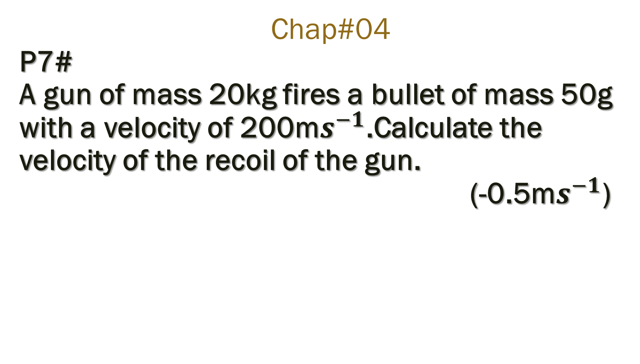
Chap#04 P7# A gun of mass 20kg fires a bullet of mass 50g with a velocity of 200m$s^{−1}$.Calculate the velocity of the recoil of the gun. (-0.5m$s^{−1}$)

Slide 27
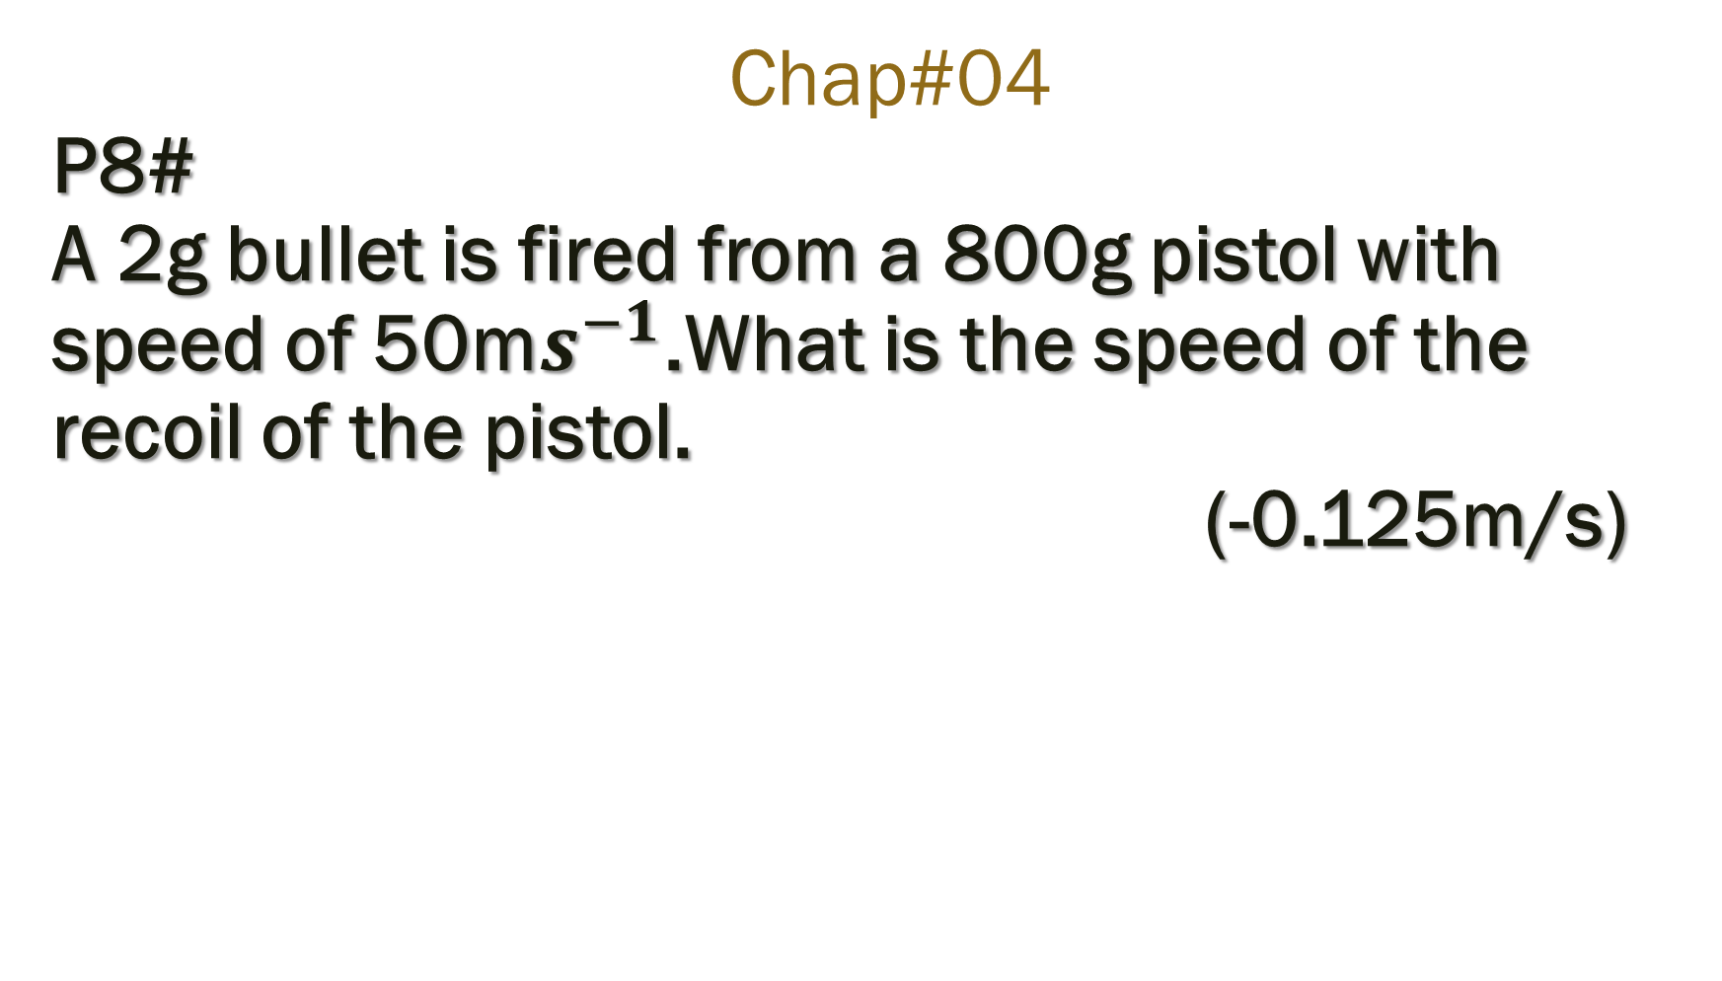
Chap#04 P8# A 2g bullet is fired from a 800g pistol with speed of 50m$s^{−1}$.What is the speed of the recoil of the pistol. (-0.125m/s)

Slide 28
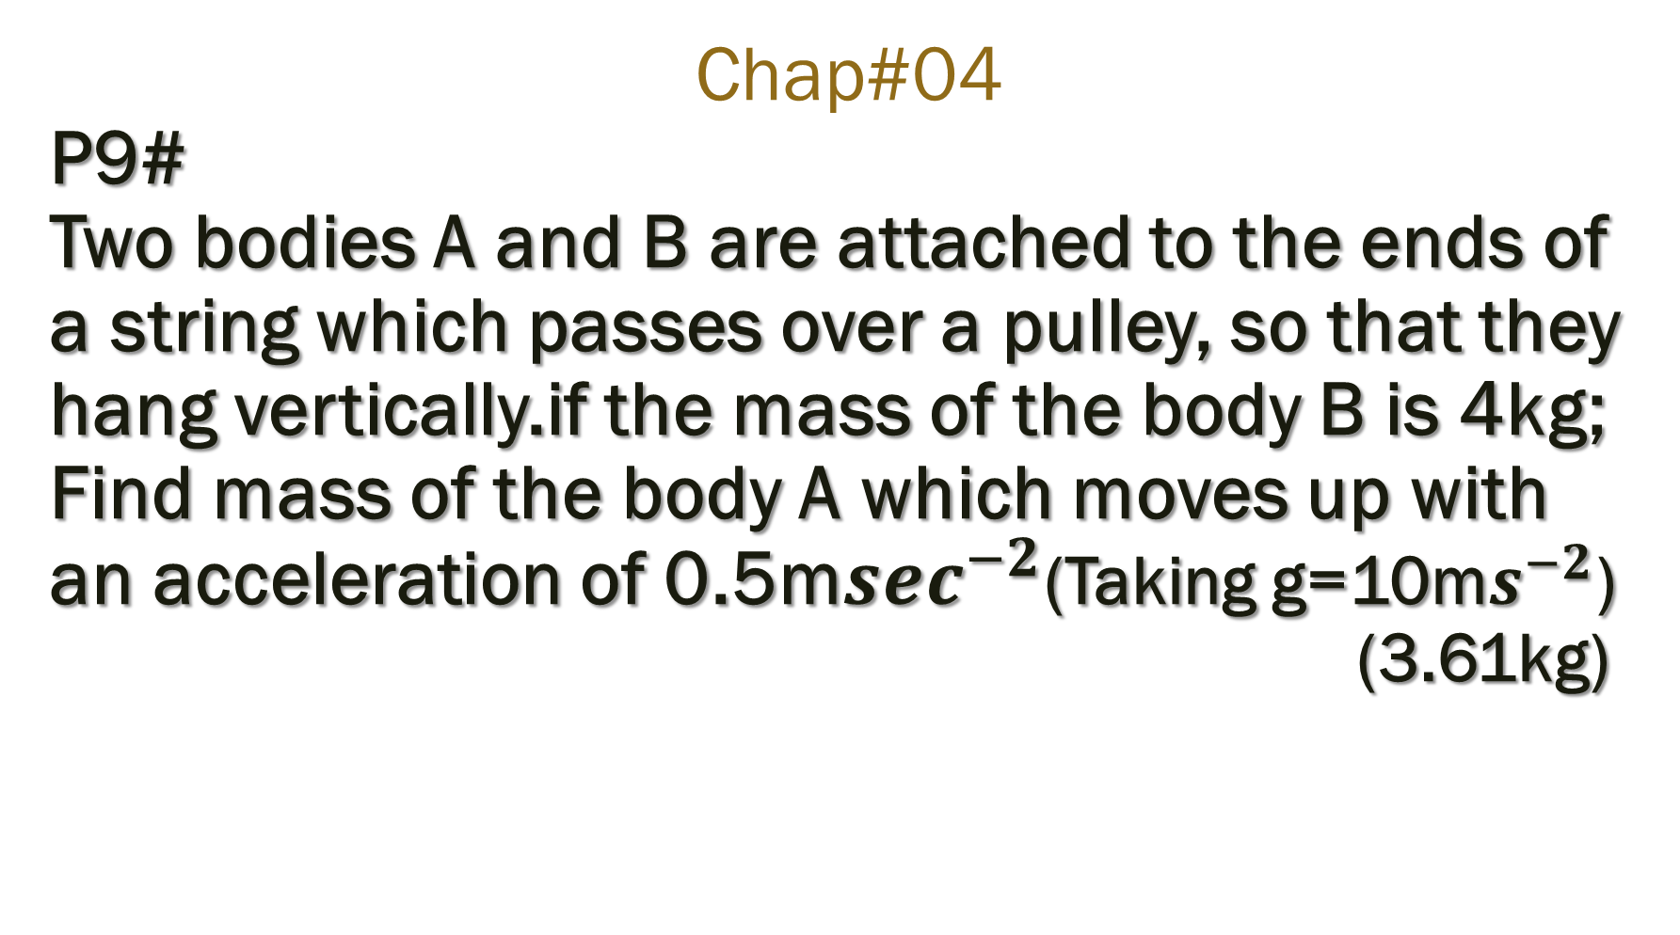
Chap#04 P9# Two bodies A and B are attached to the ends of a string which passes over a pulley, so that they hang vertically.if the mass of the body B is 4kg; Find mass of the body A which moves up with an acceleration of 0.5m$\sec^{−2}$(Taking g=10m$s^{−2}$) (3.61kg)

Slide 29
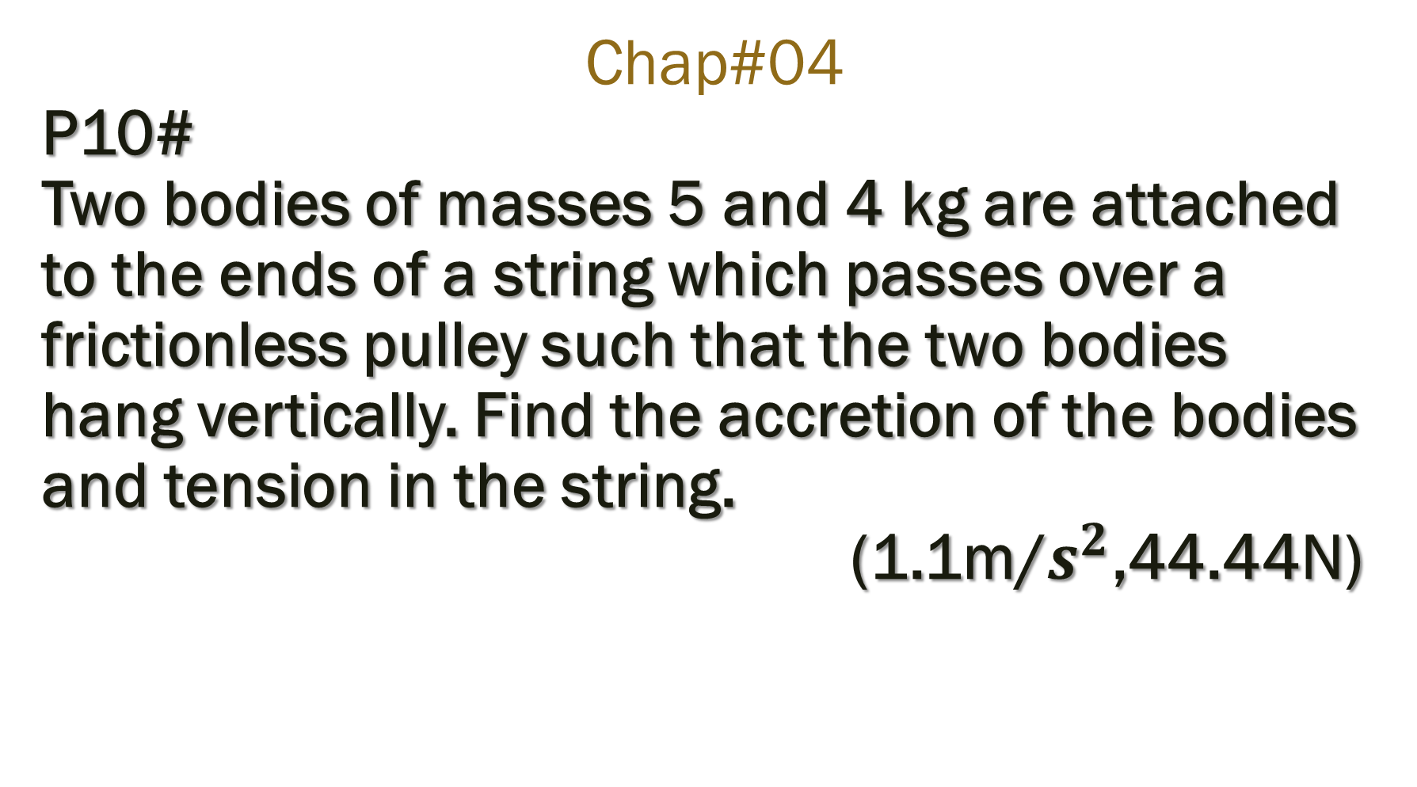
Chap#04 P10# Two bodies of masses 5 and 4 kg are attached to the ends of a string which passes over a frictionless pulley such that the two bodies hang vertically. Find the accretion of the bodies and tension in the string. (1.1m/$s^{2}$,44.44N)

Slide 30
Chap#04 P11# A rectangular metal block of mass 4kg rests on the top of a material surface the coefficient of friction between the box and the metal surface is 0.2 what force parallel to the surface is needed to move the block? (8N)

Slide 31
Chap#04 P12# A body weighting 50N is placed on a wooden table. How much force is required to set it into motion? Co-efficient of friction between the table and the body is 0.3? (15N)

Slide 32
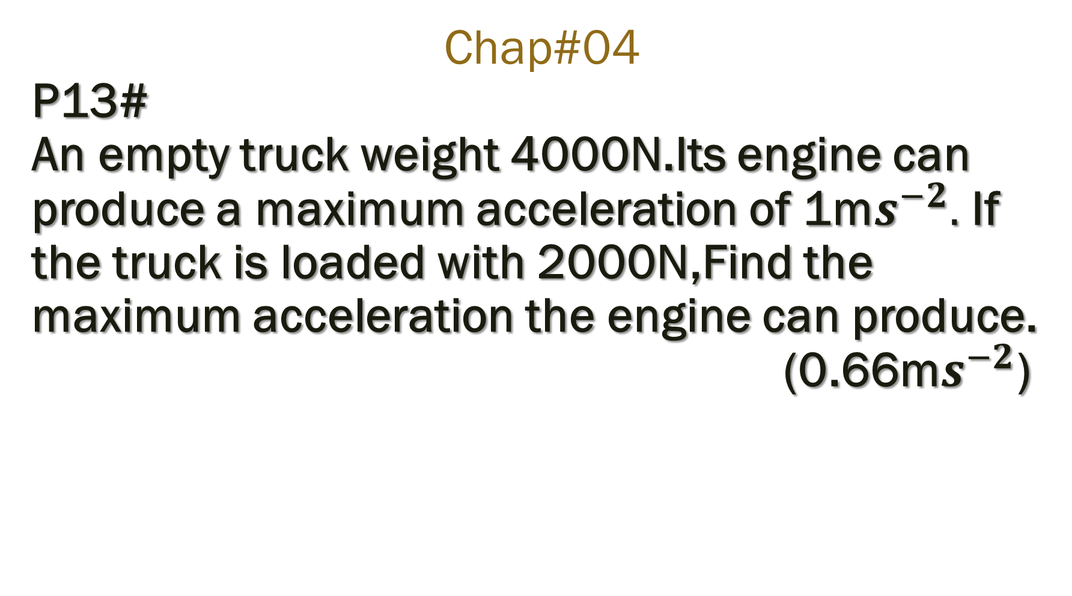
Chap#04 P13# An empty truck weight 4000N.Its engine can produce a maximum acceleration of 1m$s^{−2}.$If the truck is loaded with 2000N,Find the maximum acceleration the engine can produce. (0.66m$s^{−2}$)

